Slide 1
The Future is Theirs
Raymore-Peculiar School District

Slide 2
Our Team
Dr. Kari Monsees, Superintendent
Dr. Al Voelker, Assistant Superintendent
Dr. Kristel Barr, Director of Secondary
Jake Wingo, Community Partnership Coordinator

Slide 3
一Malcolm X
“Education is the passport to the future, for tomorrow belongs to those who prepare for it today.”
Notes:
But is it? Is our current education system a passport to an unknown and constantly evolving future?
We would say...not yet.
According to a 2017 survey conducted by Youth Trust, only 46% of high school students believed what they studied in school was relevant to their future.
According to the 2019 Job Outlook Data from NACE (National Association of Colleges and Employees), the top essential skills needed are critical thinking, teamwork/collaboration, work ethic and communication. Are these skills the top focus in our current system? Not in an authentic, real-world manner, no.
Hence our need to change and create authentic, real world experiences for our students...so we are a student’s passport to the future.

Slide 4
Real World Learning Is...
Focused on providing students with the content and skills needed in the workplace through problem-based learning, client connected projects, internships, mentorships, workshops, etc.
Bridging the gap for teachers and students between schools and industry to provide a more seamless educational experience for students.
Better preparing all students for their post-secondary journey.
Notes:
So what is real world learning?
Our definition…

Slide 5
Mission: Preparing each student for a successful and meaningful Life.
Vision: A future-focused community with a commitment to lifelong learning.
Notes:
How RWL fits into our mission, vision and strategic plan

Slide 6
Current Conditions
* Combined total of all categories is 39.9%. The unduplicated student count with one or more MVAs is 33.3%.
 |  | Total Percent of 2020 Graduates with an MVA*
School Name | Total Number | Work Experiences |  | College Credit (9 hours from DC, AP and/or IB) | Regionally Vetted IRCs | Entrepreneurial | Emerging MVAs
 |  | Internships | Client Projects
RPHS | 408 | 8.8% | 3.7% | 24.0% | 3.4% | 0% | 0%

Slide 7
The Design Team
Members
History
Process
Notes:
Overview of membership
History--started in 2017, started STEAM Extravaganza and DRIVE project, watched Most Likely to Succeed
3 question process we used this year--
What are we already doing that we can expand upon?
What are things we are doing that aren’t quite to an MVA level that we can enhance?
What do we want to explore as a new opportunity (create)?

Slide 8
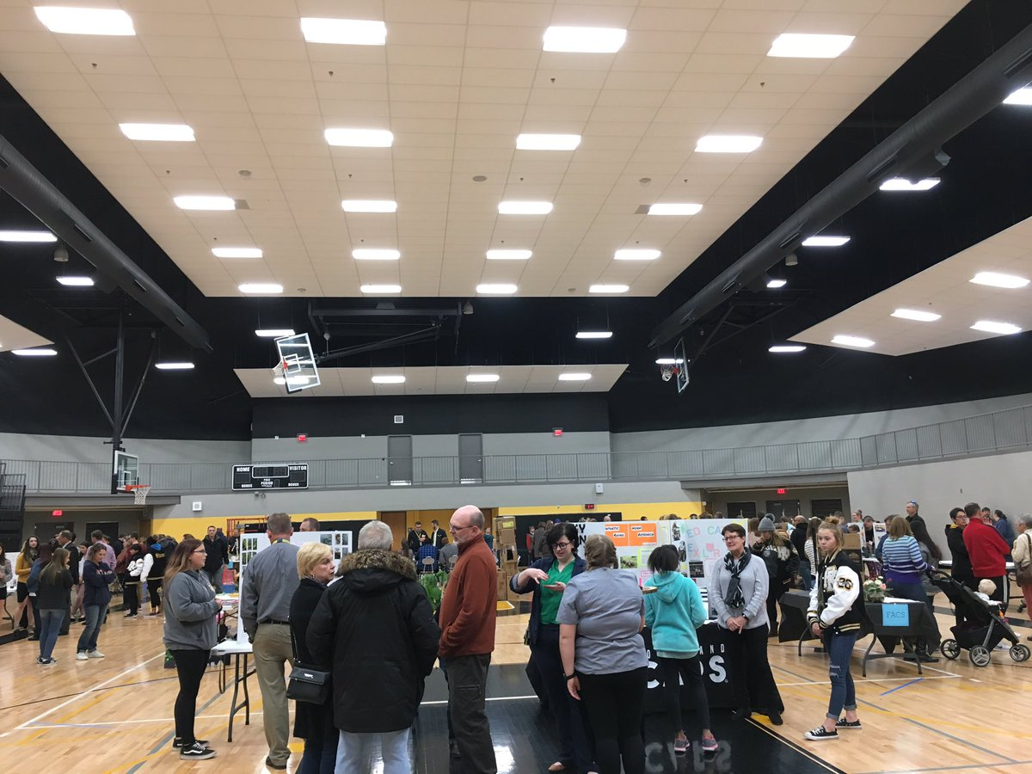
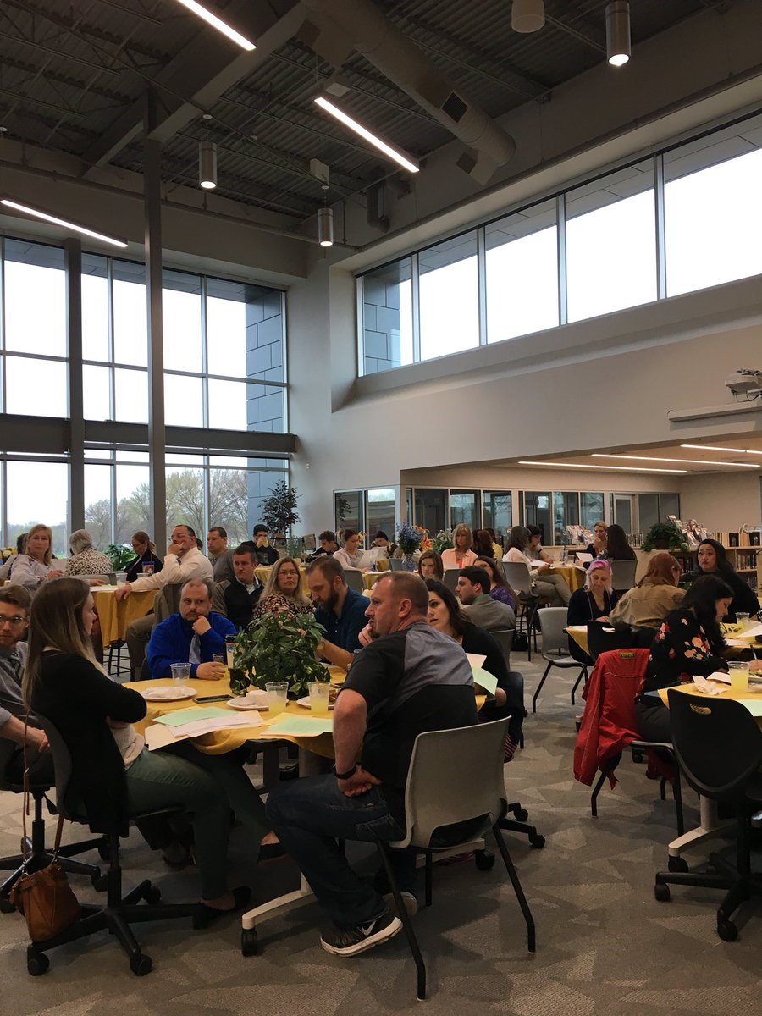
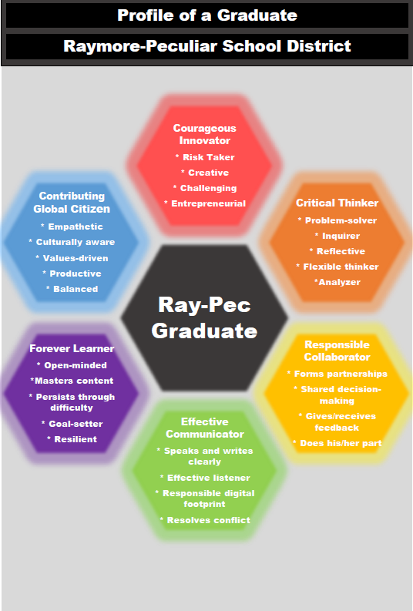
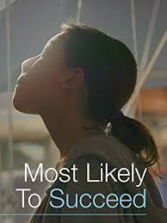
THE COMPANY
DATA ANALYTICS
01
02
BUSINESS OBJECTIVES
03
04
Here you could describe the topic of the section
Here you could describe the topic of the section
Here you could describe the topic of the section
Notes:
Major activities of the Innovation Committee in addition to guiding the RWL initiative.
1--STEAM Expo
2--DRIVE project
3--Viewing/discussion of Most Likely to Succeed
4--Drafting a Profile of a Ray-Pec graduate

Slide 9
Primary Goals
Goal 1
Goal 2
By May 2023, 90% of Raymore-Peculiar students will earn at least one Market Value Asset prior to graduation.
By May 2026, 100% of Raymore-Peculiar students will earn at least one Market Value Asset prior to graduation.

Slide 10
Building the Foundation
Community Engagement
Employer Engagement
Notes:
To make sure that we were preparing students for the Real World we repurposed our Innovation Committee to ensure that we were receiving industry input on our design process.
18 business partners represented across 7 industries
Traditional recruiting methods but with a much easier sell
Prospecting partners, target industries
Cold calls, in-person meetings, video calls, andq networking meetings
Key was to avoid telling businesses how they need to work with us in order to be a part of RWL
Tell them about everything and ask them how they WANT to be involved and a POC
Eased sense of obligation and the need for the easy button to start
Implemented CRM to store and organize partners based on industry and/or their RWL interest
Easy to go find a company that is in the manufacturing industry that is interested in hosting internships

Slide 11
Areas of Focus
Enhance
Create
Expand

Slide 12
DRIVE projects
Client Connected Projects
Professional Development
Enhance
Notes:
Every senior in an English 4 course will participate in a Client Connected Project
Sections of English 4 will be divided into broad career interests to boost engagement
Health & Human Services / Business, Management, and Technology / Industrial & Engineering Technology
Students will work in groups of 3-5 on a year-long project proposed by employers
Project selection process from students after proposal presentations from employers
Plan to expand this to all senior English classes in some way - likely less extensive projects
Hope to expand these to other areas of learning as we get better at it
In order to make all of this work we need to prepare our teachers
PD visits to businesses for all teachers
Started with electives because they have the most direct connection
Full or half day experiences to learn about different industries their students will be entering
They’ve really enjoyed them so far and seem to prefer them to being in the building
Always surprised by how much they learn.
PBL training for all teachers that are leading client connected projects - growing numbers over time.

Slide 13
Capstone Pathways
Core-Integrated Microschool
Create
Notes:
By fall 2023, there will be internship opportunities built into the master schedule that are designed as capstone courses in each of the following career pathway areas: Advanced Manufacturing, Engineering and Design, Biomedical Sciences, and Computer Science.

Slide 14
Dual Credit / Early College
Internal Internships
External Internships
Expand
Notes:
By May 2023, the Raymore-Peculiar School District will expand the percentage of students earning an MVA through dual credit coursework (9 hours of credit) from 24% to 35% (this includes AP, IB and Seal of Biliteracy completers as well).
https://docs.google.com/document/d/1iXqECW3cQZL-6JbopeASnl9YEJVdzp_7vbMRb0ixPFw/edit?usp=sharing
By fall 2023, Raymore-Peculiar students will have intentional pathways in some of the region’s most in-demand fields that end in an internal or external CTE internship opportunity, including Advanced Manufacturing, Engineering and Design, Biomedical Sciences and Computer Science.
By fall 2023, there will be internship opportunities built into the master schedule that are designed as capstone courses in each of the following career pathway areas: Advanced Manufacturing, Engineering and Design, Biomedical Sciences, and Computer Science.
https://docs.google.com/document/d/1WDCbnHSH-XZeYbj1pHMdZK4tGAG93p-F7Jgwl9S1YY8/edit?usp=sharing

Slide 15
Conditions to Support
Staffing
Professional Development
Policies and Procedures
Equity and Access
Notes:
Staffing
Increased staffing will be necessary as programs are developed and enrollment increases. Some staffing changes have been necessary during the design stage.
community partnership coordinator.
Machining Program
expand in the area of biomedical sciences by partnering with Cass Regional Medical Center
dual enrollment opportunities for students
visiting scholar program offered by the state
professor of record option in high need subject areas.
In addition, the district will utilize the locally developed ‘portrait of a Ray-Pec educator’ to guide hiring decisions, making sure new teachers recruited into the district have a growth mindset and possess the traits and abilities needed to teach in a redesigned high school environment.
PD
The mission of the Raymore-Peculiar Professional Development Committee is to coordinate professional development activities for staff of Raymore-Peculiar for the purpose of improving student learning. These activities will align with the District’s Mission Statement, support the District Strategic Plan, and aid staff in obtaining the skills necessary to provide real world learning opportunities for students. The PDC Committee is composed of certified staff members from each educational level in the district. A key role of this committee is to establish yearly goals for staff that align with the district strategic plan. After reviewing the Raymore-Peculiar Strategic Plan, the PDC Committee set two primary goals for certified staff. The first goal addresses high quality staffing while the second goal established directly addresses project based learning.
PDC Goal 2:
By October 2020, the number of teachers and administrators receiving formal, multi-session training in project based learning will expand from 5% to 25%.
Strategic Focus Area #1 Success Ready Students: Incorporate additional real-world, hands-on learning opportunities
Expand staff professional development to support integration of more project based learning in the curriculum
Continue technology integration in support of STEAM learning experiences
Increase training opportunities in design thinking and Project Based Learning for staff
Pursue soft skill development professional development learning opportunities for teachers
Continue training staff to support social emotional skills in students
Expand Project Lead The Way and Launch training to more teachers
While this goal establishes actions during one calendar year, a multiyear approach will be used to drive long term growth in staff.
Equity and Access
Demographic analysis of the MVA data showed there were some challenges, particularly with our African American population which represented only 3% of the MVA’s but 12% of the senior class. In addition, the district reviewed free and reduced lunch data. The school F/R lunch rate is at 23.05% and the senior class F/R lunch rate is at 11%. However, F/R lunch students only represented 5% of the total students who had earned an MVA in the 2019-2020 school year.
Digging a little deeper into the data, it was noted that Ray-Pec has a portion of the Ray-Pec student population who sit in dual credit courses but do not take those courses for dual credit. In attempting to ascertain why, the data showed the following:
10% of the students did not meet the g.p.a. requirement
12% of the students had no ACT score
45% had an ACT score but it was not high enough to qualify for dual credit
33% had a qualifying g.p.a. and ACT score
7% qualify for free and reduced lunch
There are several actions the district is planning to take to address some of the concerns revealed from this data.
Sophomore talks
Sophomore ACT
ACT prep course
AP/IB Strategies bank
Financial support
Student focus groups for those who quality for DC but don’t take it for DC.
English 4 DRIVE
Policies and Procedures
School district policies and procedures are reviewed annually by the District Policy Review Team. Policies and practices that will be reviewed by administration include:
Equal Access Measures
Graduation Requirements
Transcript changes
Credit acquisition
Master Scheduling Adjustment
Attendance procedures
Embedding of credit (ELA, math) as necessary
Teacher expectations will change as well (PBL, internships, client projects, core integration, etc.)

Slide 16
Measurement
Notes:
Key metrics will focus on
student outcomes, including MVA attainment,
career pathway choice, as well as
graduation,
attendance and
post-secondary follow-up rates.
The district will track each of these measurements throughout the year through the use of the existing school information system as well as other systems such as Missouri Connections, Panorama and Satchel Pulse. Panorama will serve as the district’s data dashboard and track each piece of data on an ongoing basis. The RWL Lead team as well as building administrators will monitor the data monthly, analyzing overall trends as well as subgroup trends. Data and progress made will be shared with the Innovation Committee and the Board of Education on a regular basis.

Slide 17
Budget and Sustainability

Slide 18
一Oliver Wendell Holmes, Jr.
“A man’s mind, stretched by new ideas, may never return to its original dimensions.”
Notes:
And this is what we are hoping for the RayPec School District--that we will be stretched,challenged and re-invigorated--and our system will never be the same.

Slide 19
Questions?

